Slide 1
The Internet
Nick Troccoli
CSBridge CTU 2019

Slide 2

Learning Goals
Write a program that can make internet requests
Write a program that can respond to internet requests

Slide 3
Plan For Today
How do internet programs work?
Sending Data Over The Internet
Writing a client and server
Demo: echo
Demo: Chat

Slide 4
Plan For Today
How do internet programs work?
Sending Data Over The Internet
Writing a client and server
Demo: echo
Demo: Chat

Slide 5
Programs and the Internet
How does your phone communicate with Facebook?

Slide 6
Programs and the Internet
The Java program on your phone talks to the Java program at Facebook.

Slide 7
Facebook
Facebook Server
* Android phones run Java. So do Facebook servers!

Slide 8
Facebook
Facebook Server
Is this login ok?
troccoli@stanford.edu
Confirmed. troccoli@stanford.edu is now logged in.

Slide 9
Facebook
Facebook Server
Send me the full name for troccoli@stanford.edu
Nick Troccoli
“Nick Troccoli”

Slide 10
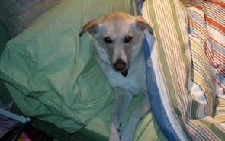
Facebook
Facebook Server
Send me the cover photo for troccoli@stanford.edu
Nick Troccoli

Slide 11
Programs and the Internet
There are two types of internet programs: clients and servers.

Slide 12
Programs and the Internet
Servers are constantly running, listening for requests to respond to.

Slide 13
Programs and the Internet
Clients send requests to servers for information they need.

Slide 14
Servers Are Computer Programs!
Facebook Server
=

Slide 15
Background: The Internet
The internet is just many programs sending messages (as Strings)
Thanks Nick for the teaching YEAH

Slide 16
Background: The Internet
Facebook datacenter
Your computer (facebook.com)
The internet is just many programs sending messages (as Strings)
Thanks Nick for the teaching YEAH

Slide 17
Background: The Internet
Facebook datacenter
Your computer (facebook.com)
“Server”
“Client”
The internet is just many programs sending messages (as Strings)
Thanks Nick for the teaching YEAH

Slide 18
Background: The Internet
Facebook datacenter
Your computer (facebook.com)
Get status for “Chris Piech”
“Server”
“Client”
The internet is just many programs sending messages (as Strings)
Thanks Nick for the teaching YEAH

Slide 19
Background: The Internet
Facebook datacenter
“response”
Your computer (facebook.com)
“Enjoying lecture”
Get status for “Chris Piech”
“Server”
“request”
“Client”
The internet is just many programs sending messages (as Strings)
Thanks Nick for the teaching YEAH

Slide 20
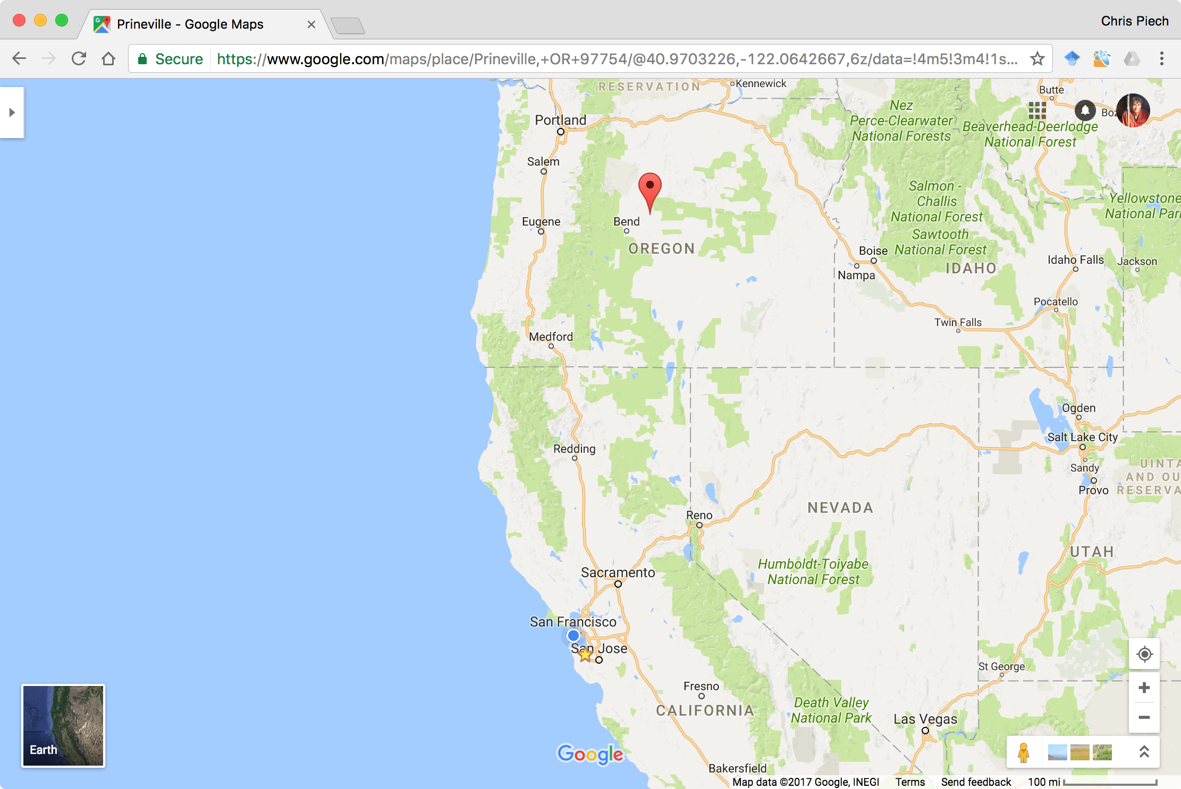
Face Book Server
The Internet

Slide 21
Face Book Server
The Internet
Get status for piech@cs.stanford.edu

Slide 22
Face Book Server
The Internet

Slide 23
Face Book Server
The Internet

Slide 24
teaching
Face Book Server
The Internet

Slide 25
teaching
Face Book Server
The Internet

Slide 26
Face Book Server
The Internet

Slide 27
Many programs can connect to the same server

Slide 28
The Internet
Facebook datacenter
RESPONSE
REQUEST
REQUEST
RESPONSE
“Server”
“Client”
“Client”
“Client”

Slide 29
Most of the Internet
Aka “the frontend”
Aka “the backend”
Server / Clients
Aka “the cloud”
Aka “the GUI”
Aka “the database”

Slide 30
Plan For Today
How do internet programs work?
Sending Data Over The Internet
Writing a client and server
Demo: echo
Demo: Chat

Slide 31



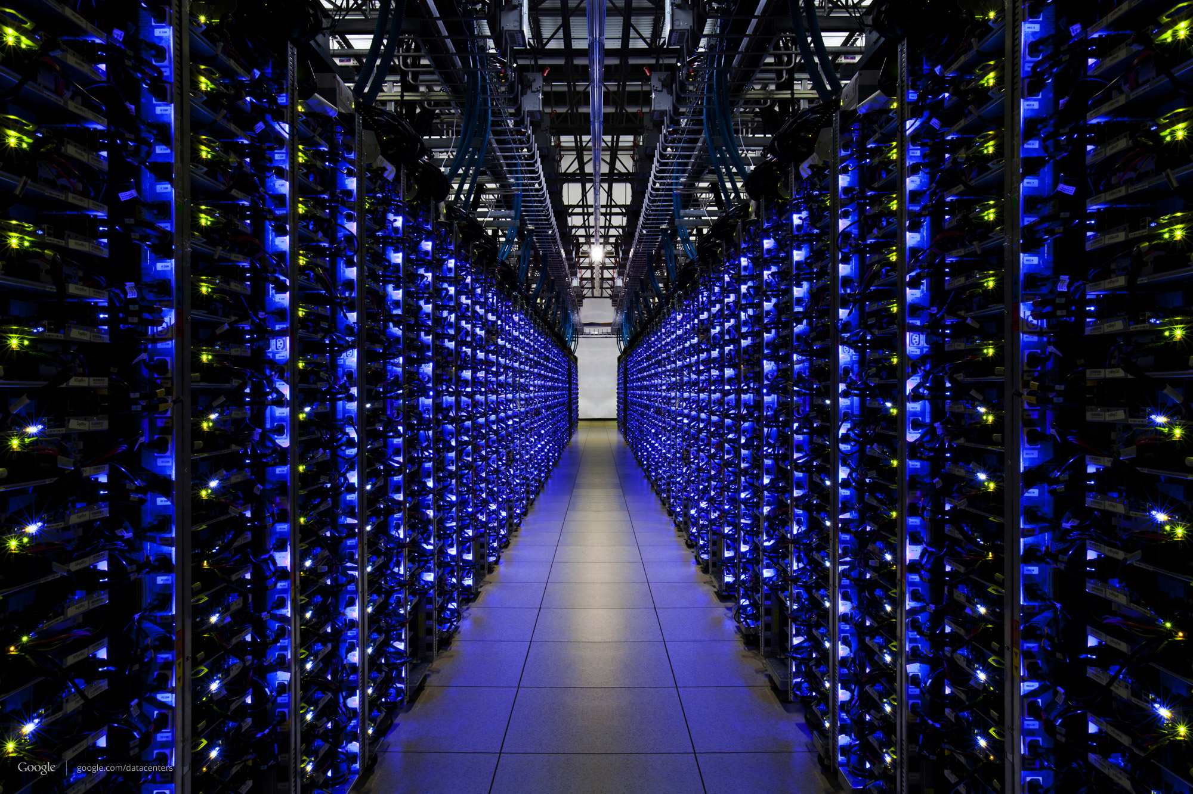
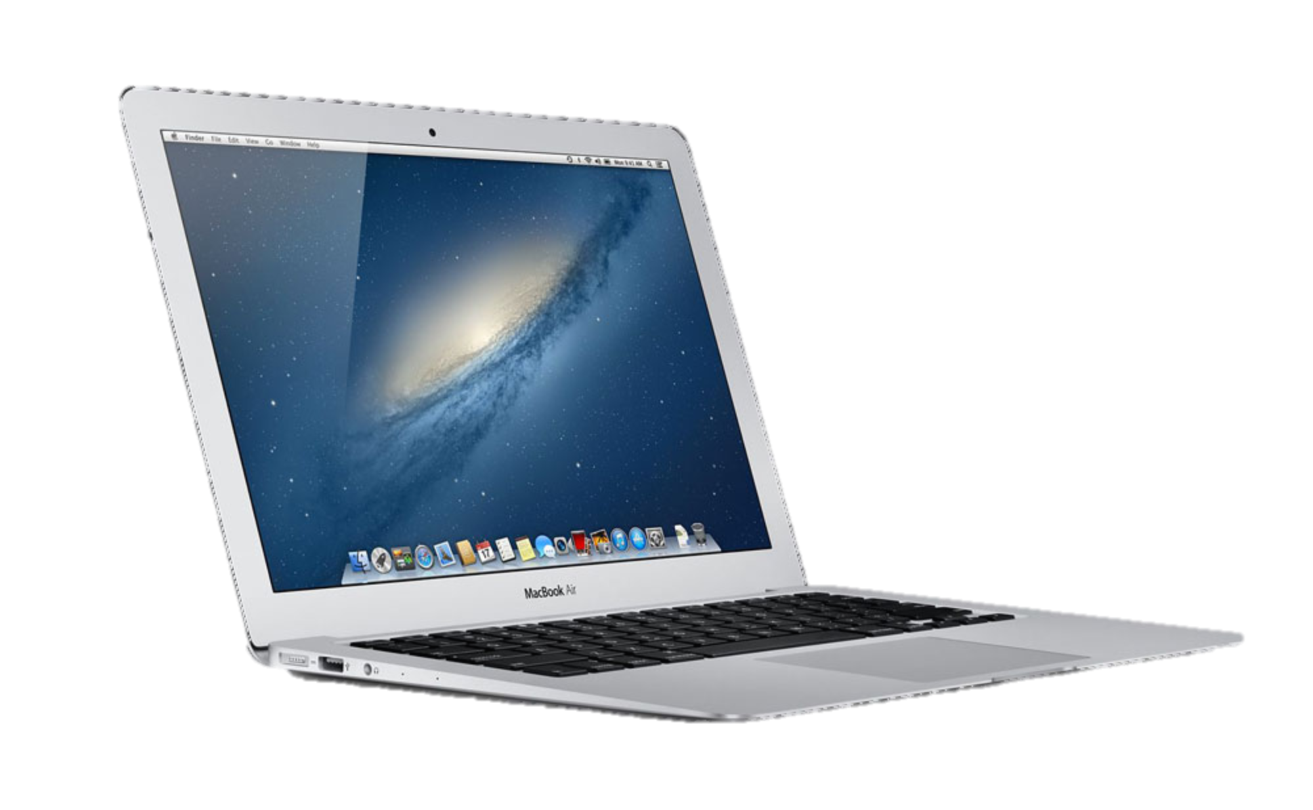

Slide 32

Someone else’s
Java Program
My Java
Program

Slide 33

Data
Data

Slide 34
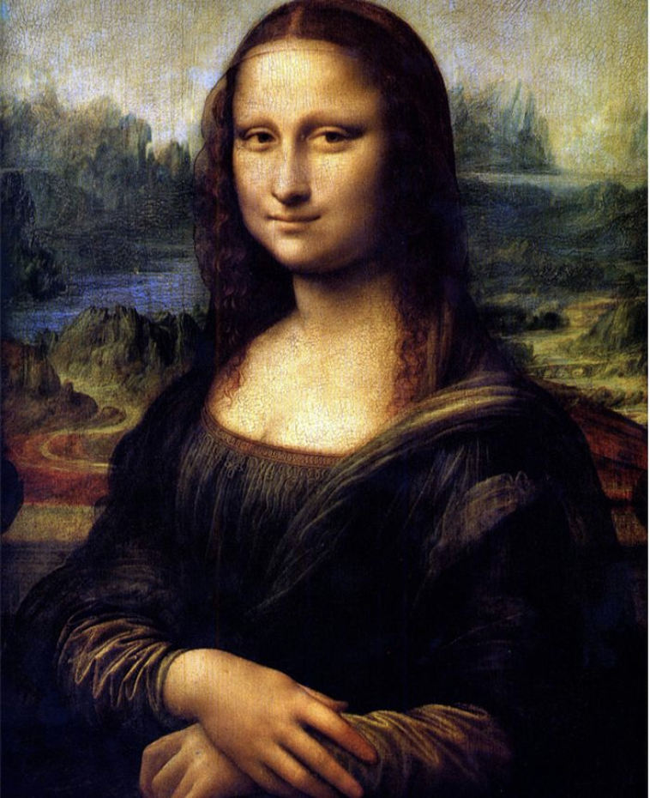
Notes:
Let’s see how this image is sent across the Internet from one smartphone to another….

Slide 35
Notes:
Let’s see how this image is sent across the Internet from one smartphone to another….

Slide 36
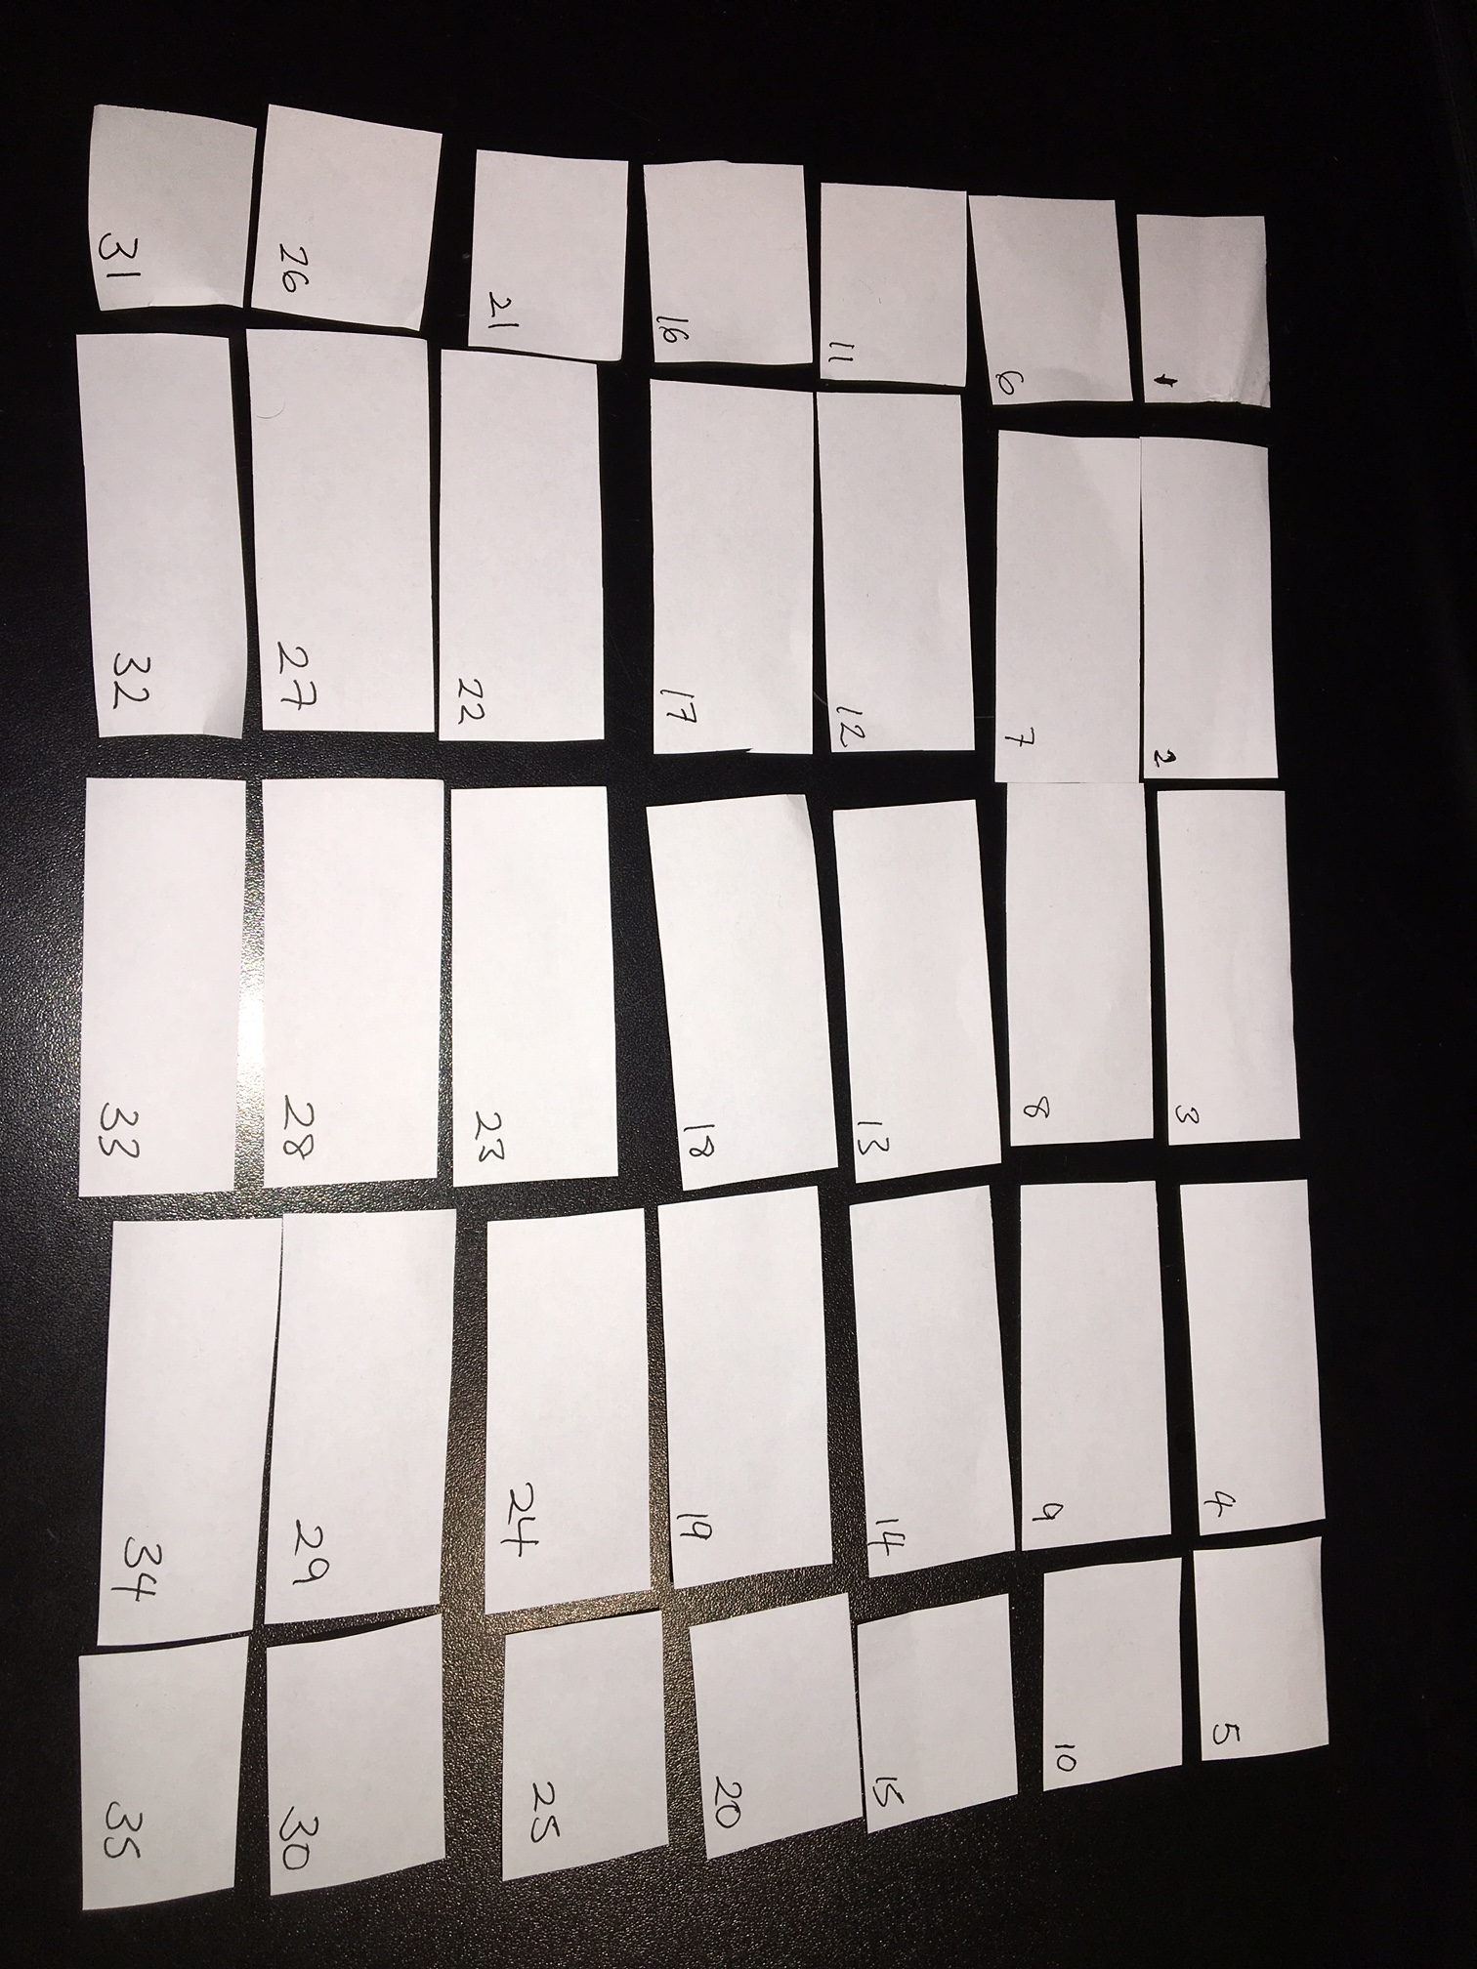

Slide 37
Packets may be damaged
?!%%*
Data
Data

Slide 38
Packets may arrive out of order
1
2

Slide 39
Packets may be duplicated
Duplicate
Data
Data

Slide 40
They may not arrive at all!
Data
Data
Full

Slide 41
The Internet Is Unreliable
Applications send and receive data in packets….
…over an Internet that is unreliable.
Software on the devices themselves compensates for this.

Slide 42
Let’s send a message to Chris over the “CSBridgeNet”

Slide 43
Plan For Today
How do internet programs work?
Sending Data Over The Internet
Writing a client and server
Demo: echo
Demo: Chat

Slide 44
Servers
Request
someRequest
String
serverResponse
Server

Slide 45
Servers on one slide
public String requestMade(Request request) {
// server code goes here
}
1
2
// make a Server object
private SimpleServer server
= new SimpleServer(this, 8000);
3
public void run(){
// start the server
server.start();
}

Slide 46
A Server’s Simple Purpose
public String requestMade(Request request) {
// server code goes here
}
1
2
// make a Server object
private SimpleServer server
= new SimpleServer(this, 8000);
3
public void run(){
// start the server
server.start();
}

Slide 47
A Server’s Simple Purpose
public String requestMade(Request request) {
// server code goes here
}
1
2
// make a Server object
private SimpleServer server
= new SimpleServer(this, 8000);
3
public void run(){
// start the server
server.start();
}

Slide 48
What is a Port?

Slide 49
Servers on one slide
public String requestMade(Request request) {
// server code goes here
}
1
2
// make a Server object
private SimpleServer server
= new SimpleServer(this, 8000);
3
public void run(){
// start the server
server.start();
}

Slide 50
What is a Request?
/* Request has a command */
String command;
/* Request has parameters */
HashMap<String,String> params;
Request request
// methods that the server calls on requests
request.getCommand();
request.getParam(key); //returns associated value

Slide 51
Plan For Today
How do internet programs work?
Sending Data Over The Internet
Writing a client and server
Demo: echo
Demo: Chat

Slide 52
Our First Server
public class EchoServer extends ConsoleProgram implements SimpleServerListener {
private SimpleServer server = new SimpleServer(this, 8090);
public void run() {
server.start();
println("Starting server...");
}
public String requestMade(Request request) {
String cmd = request.getCommand();
int cmdLength = cmd.length();
return "Your command was " + cmdLength + " chars long.";
}
}

Slide 53
Our First Server
public class EchoServer extends ConsoleProgram implements SimpleServerListener {
private SimpleServer server = new SimpleServer(this, 8090);
public void run() {
server.start();
println("Starting server...");
}
public String requestMade(Request request) {
String cmd = request.getCommand();
int cmdLength = cmd.length();
return "Your command was " + cmdLength + " chars long.";
}
}

Slide 54
Our First Server
public class EchoServer extends ConsoleProgram implements SimpleServerListener {
private SimpleServer server = new SimpleServer(this, 8090);
public void run() {
server.start();
println("Starting server...");
}
public String requestMade(Request request) {
String cmd = request.getCommand();
int cmdLength = cmd.length();
return "Your command was " + cmdLength + " chars long.";
}
}

Slide 55
Our First Server
public class EchoServer extends ConsoleProgram implements SimpleServerListener {
private SimpleServer server = new SimpleServer(this, 8090);
public void run() {
server.start();
println("Starting server...");
}
public String requestMade(Request request) {
String cmd = request.getCommand();
int cmdLength = cmd.length();
return "Your command was " + cmdLength + " chars long.";
}
}

Slide 56
Our First Server
public class EchoServer extends ConsoleProgram implements SimpleServerListener {
private SimpleServer server = new SimpleServer(this, 8090);
public void run() {
server.start();
println("Starting server...");
}
public String requestMade(Request request) {
String cmd = request.getCommand();
int cmdLength = cmd.length();
return "Your command was " + cmdLength + " chars long.";
}
}

Slide 57
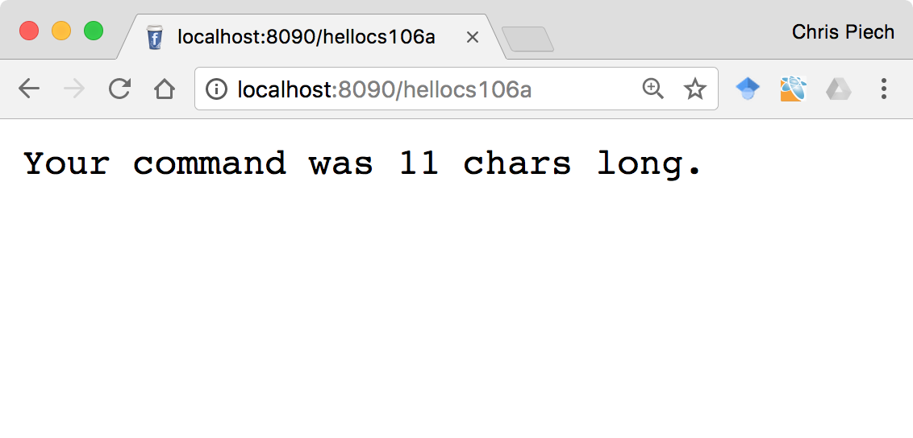
Echo Server

Slide 58
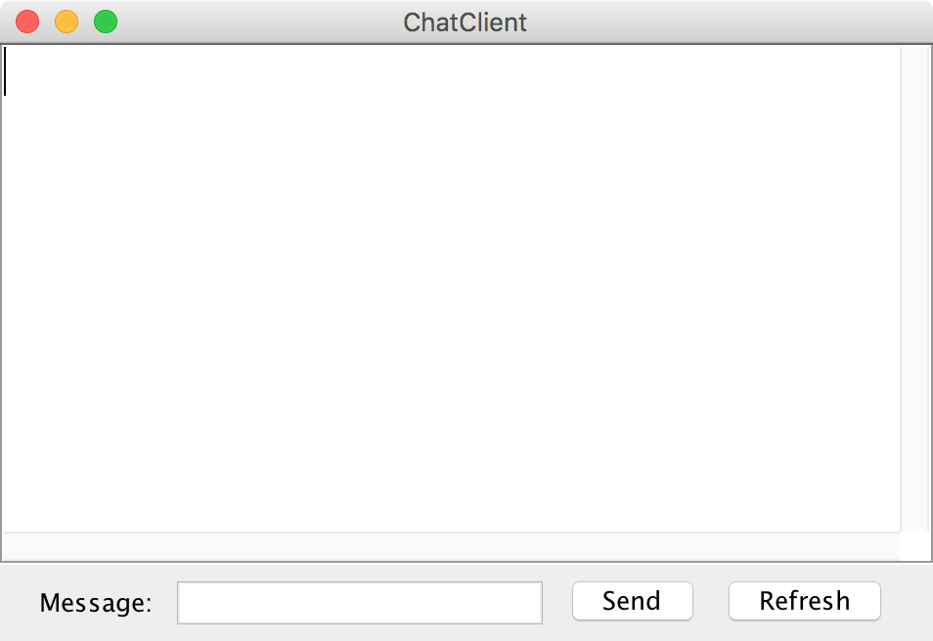
Clients
Chat Client
Chat Client
> Hello world
> Hello world
Send
Send

Slide 59
Clients on one slide
try {
// 1. construct a new request
Request example = new Request("getStatus");
// 2. add parameters to the request
example.addParam("name", "chris");
// 3. send the request to a computer on the internet
String result = SimpleClient.makeRequest(HOST, example);
} catch(IOException e) {
// The internet is a fast and wild world my friend
}

Slide 60
Clients on one slide
try {
// 1. construct a new request
Request example = new Request("getStatus");
// 2. add parameters to the request
example.addParam("name", "chris");
// 3. send the request to a computer on the internet
String result = SimpleClient.makeRequest(HOST, example);
} catch(IOException e) {
// The internet is a fast and wild world my friend
}

Slide 61
Clients on one slide
try {
// 1. construct a new request
Request example = new Request("getStatus");
// 2. add parameters to the request
example.addParam("name", "chris");
// 3. send the request to a computer on the internet
String result = SimpleClient.makeRequest(HOST, example);
} catch(IOException e) {
// The internet is a fast and wild world my friend
}

Slide 62
Clients on one slide
try {
// 1. construct a new request
Request example = new Request("getStatus");
// 2. add parameters to the request
example.addParam("name", "chris");
// 3. send the request to a computer on the internet
String result = SimpleClient.makeRequest(HOST, example);
} catch(IOException e) {
// The internet is a fast and wild world my friend
}

Slide 63
Clients on one slide
try {
// 1. construct a new request
Request example = new Request("getStatus");
// 2. add parameters to the request
example.addParam("name", "chris");
// 3. send the request to a computer on the internet
String result = SimpleClient.makeRequest(HOST, example);
} catch(IOException e) {
// The internet is a fast and wild world my friend
}

Slide 64
Clients on one slide
try {
// 1. construct a new request
Request example = new Request("getStatus");
// 2. add parameters to the request
example.addParam("name", "chris");
// 3. send the request to a computer on the internet
String result = SimpleClient.makeRequest(HOST, example);
} catch(IOException e) {
// The internet is a fast and wild world my friend
}

Slide 65
Clients on one slide
try {
// 1. construct a new request
Request example = new Request("getStatus");
// 2. add parameters to the request
example.addParam("name", "chris");
// 3. send the request to a computer on the internet
String result = SimpleClient.makeRequest(HOST, example);
} catch(IOException e) {
// The internet is a fast and wild world my friend
}

Slide 66
Clients on one slide
try {
// 1. construct a new request
Request example = new Request("getStatus");
// 2. add parameters to the request
example.addParam("name", "chris");
// 3. send the request to a computer on the internet
String result = SimpleClient.makeRequest(HOST, example);
} catch(IOException e) {
// The internet is a fast and wild world my friend
}

Slide 67
Example: Echo Client
Notes:
Walkthrough

Slide 68
Plan For Today
How do internet programs work?
Sending Data Over The Internet
Writing a client and server
Demo: echo
Demo: Chat

Slide 69
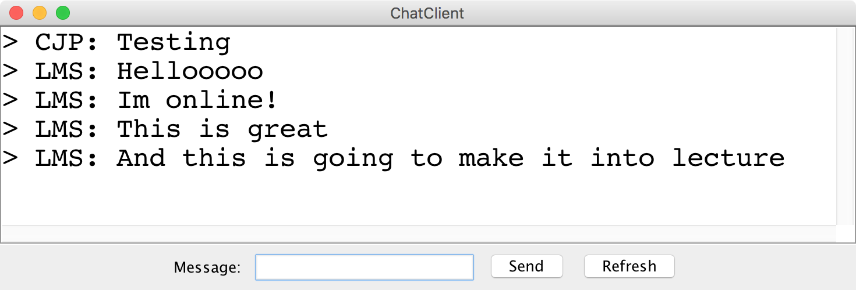
Chat Server and Client

Slide 70

history = [
]
addMsg
msg = C: Hello world
Chat Client
Chat Client
Send
Hello world
Send

Slide 71
history = [
C: Hello world
]
getMsgs
index = 0
Chat Client
Chat Client
Send
Send

Slide 72
history = [
C: Hello world
]
[C: Hello world]
Chat Client
Chat Client
> C: Hello world
> C: Hello world
Send
Send

Slide 73
history = [
C: Hello world
]
addMsg
msg = B: Im here too
Chat Client
Chat Client
> C: Hello world
> C: Hello world
Im here too
Send
Send

Slide 74
history = [
C: Hello world,
B: Im here too
]
getMsgs
index = 1
Chat Client
Chat Client
> C: Hello world
> C: Hello world
Send
Send

Slide 75
history = [
C: Hello world,
B: Im here too
]
[B: Im here too]
Chat Client
Chat Client
> C: Hello world
> C: Hello world
> B: Im here too
> B: Im here too
Send
Send

Slide 76
Chat Server
addMsg
msg = text
Chat Server
getMsgs
index = startIndex

Slide 77
Let’s Code It Together!

Slide 78
Recap
How do internet programs work?
Sending Data Over The Internet
Writing a client and server
Demo: echo
Demo: Chat

